Slide 1



PYTHON MICRO PROJECT SNAKE AND LADDER
PROJECT MEMBERS:
1) MOUNISHWARAN.A – 23ITR102
2) NAVAJEEVAN.K.S – 23ITR109
3) PRAVEEN KUMAR.E – 23ITR119
HARI D (19ITR028)

Slide 2

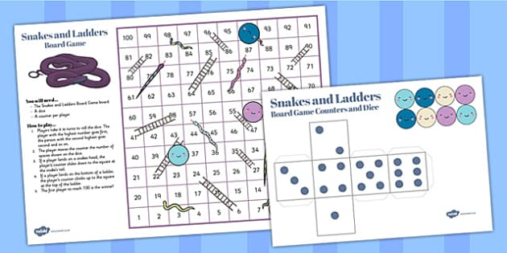
Snakes and Ladders is a board game where players take turns rolling a die and moving their token on a board with numbered squares, snakes, and ladders

Slide 3
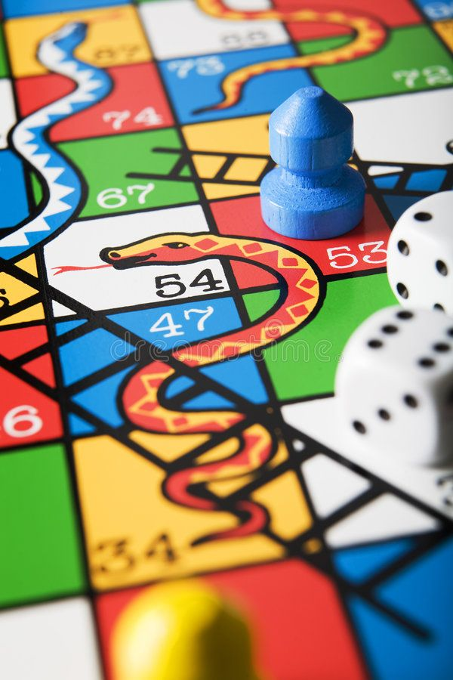
Objectives
Create a command-line version of the classic "Snakes and Ladders" game using Python. The goal is to simulate the traditional gameplay, where players race to reach the final square on a 10x10 board, avoiding snakes that slide them down and using ladders to climb up
3

Slide 4
Software / Hardware Tools used
IDLE (Python 3.12 64-bit)
Python IDLE is a text-based integrated development and learning environment (IDLE) that comes with the Python programming language. It has built-in tools for writing, running, and debugging Python programs
Some of its features include :
Interactive shell
Code Editor
Built-in debugger
Cross-platform compatibility
Open-source and free
4

Slide 5
Implementation Details
Use Python’s random module to simulate dice rolls.
Maintain the board and player positions using data structures like lists and dictionaries.
Display the current state of the board after each turn, including the positions of all players.
The game should support 2 to 4 players.
The board consists of 100 squares arranged in a 10*10 grid.
Snakes and ladders are placed on the board at the predefined position.
A player’s position is determined by the roll of the dice.
If a player lands at the base of a ladder, they climb to the top.
If a player lands on the head of a snake, they slide down to the tail.
The first player to reach or exceed square 100 wins the game.
5

Slide 6
Modules
1) Roll_dice () - it is used to generate random number between 1 to 6 when pressed enter
2) move_player()- it is used to move the player current position to recently generated position
3) playgame()- to start the game

Slide 7
Reference
https://www.geeksforgeeks.org/design-snake-and-ladder-game-using-python-oops/
https://pythoncircle.com/post/676/text-based-snake-and-ladder-game-in-python/
https://www.tutorialspoint.com/snake-and-ladder-problem
https://www.youtube.com/watch?v=8dfePlONtls

Slide 8
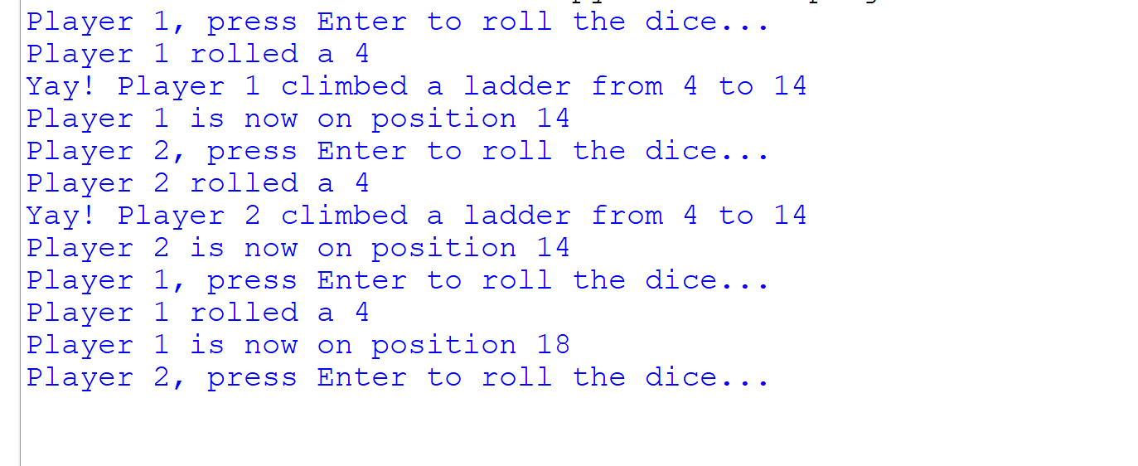
The Output

Slide 9
The coding
import random
snakes = {16: 6, 47: 26, 49: 11, 56: 53, 62: 19, 64: 60, 87: 24, 93: 73, 95: 75, 98: 78}
ladders = {1: 38, 4: 14, 9: 31, 21: 42, 28: 84, 36: 44, 51: 67, 71: 91, 80: 100}
def roll_dice():
return random.randint(1, 6)
def move_player(player, current_position):
input(f"{player}, press Enter to roll the dice...")
dice_value = roll_dice()
print(f"{player} rolled a {dice_value}")
current_position += dice_value
if current_position in snakes:
print(f"Oops! {player} got bitten by a snake and moved from {current_position} to {snakes[current_position]}")
current_position = snakes[current_position]
elif current_position in ladders:
print(f"Yay! {player} climbed a ladder from {current_position} to {ladders[current_position]}")
current_position = ladders[current_position]
print(f"{player} is now on position {current_position}")
return current_position

Slide 10
def play_game():
player1 = "Player 1"
player2 = "Player 2"
player1_position = 0
player2_position = 0
while True:
player1_position = move_player(player1, player1_position)
if player1_position >= 100:
print(f"{player1} wins!")
break
player2_position = move_player(player2, player2_position)
if player2_position >= 100:
print(f"{player2} wins!")
break
play_game()

Slide 11
Thank you!

